Slide 1
R 소개

Slide 2
R 언어
R 다운로드 및 설치
Data 가져오기와 내보내기
기초적인 통계 분석

Slide 3

Introduction to R
R 소개

Slide 4
R
통계 및 데이터 분석용 소프트웨어
역사
S 언어에 기반
미국 Bell Lab 에서 전화 요금 계산을 위하여 John Chamber 가 개발 (1976)
R 언어
통계 계산 및 그래픽을 위한 도구
뉴질랜드 오클랜드에서 Robert Gentleman, Ross Ihaka 교수가 개발을 시작 (1992)
GPL 라이선스로 소스코드를 공개
R 코어 그룹에서 개발 2000년에 R 1.0.0 으로 배포
특성
Free and Open Source Software
Programming Environment
Interpreted Language
Batch mode, interactive mode 가 가능
Large Data Storage, Analysis, Graphing 에 적합
Notes:
R is a software that provides a programming environment for doing statistical data analysis. This software was written by Robert Gentleman and Ross Ihaka and the name of the software bear the name of the creators. It is a free implementation of S, another popular statistical software. R can be effectively used for data storage, data analysis and a variety of graphing functions. R is distributed free and it is an open source software.

Slide 5
R 언어 및 개발 환경
R foundation
R 언어 표준 및 패키지관리
www.r-project.org(공식 R 웹사이트):
CRAN(다운로드 사이트)
Current Version: R-4.02 (2020.08)
CRAN(Comprehensive R Archive Network)
http://cran.r-project.org(R 배포사이트)
R base 및 Rgui(IDE) 제공 - Linux, Window, Mac 버전
Rstudio → https://rstudio.com/
상용화된 IDE, 기본 버전은 무료
rmarkdown – notebook style, HTML, PPT 포맷으로 변환
Web Note Style
colab, kaggle, jupyter, bookdown, 등
Notes:
The current version of R is R-2.0.0. The development cycle of R is very rapid, and almost every six months (April and October), new versions of R are out. In between, alpha and beta versions are put on the websites for testing. The source codes and binary versions of R can be downloaded from http://cran.r-project.org. It has many mirrors. In addition to downloading R directly from the website, it can also be obtained on a CD in many linux distributions, and you can also write to me for obtaining R.

Slide 6
장단점
장점
Free and open source
사용자 Community
확장성, 유연성이 크다.
고급 통계, 데이터 분석 도구 구현 – Package
다양한 그래픽 기능
분석 알고리즘 함수에서 parameter 에 대하여 스마트한 default value 를 제공
약점
효율적으로 사용하기 위해서, 고급 기능을 사용하기 위해서는 학습이 필요함
interpreter 방식이므로 대용량의 데이터에 대하여 속도 저하
소프트웨어 개발 보다는 데이터 분석용 언어 및 플랫폼
데이터 분석을 위한 프로그래밍, 분석 결과에 대한 presentation
Notes:
R is a great software. It is freely distributed (free both in price as well as in freedom of usage, no restrictions). It has a very strong user community who are ready to help newbies and share information. It has extensive documentation. Best of all, it is extremely scalable, meaning from very low end to very high end, all types of statistical methods can be easily implemented using R. The graphics of R are very flexible and there are many intelligent defaults. Intelligent defaults mean R can guess what you are trying to do and act accordingly.
On the downside, it can be time-consuming to learn to use it effectively. The learning process is slow, sometimes frustrating, but in the end, it is a rewarding experience. However, for very large datasets, R can sometimes be slow, but there are several ways to speed up R. The newer versions are invariably faster than the older ones, so continuous upgrading of the software is a good way to speed things up.

Slide 7
R
Data object – 데이터 객체
Atomic – vector, matrix(벡터의 확장, 또는 벡터의 벡터)
Non-atomic – 리스트, 데이터 프레임(벡터의 리스트, 테이블)
Package, function – 패키지, 함수
풍부한 라이브러리
분석 알고리즘이 패키지 형태로 구현되어 있음.
패키지 설치 후 로드하여 사용
Object Oriented – 객체 지향
모든 것이 객체
함수 객체를 다른 함수의 parameter 로 사용
Overloading
Functional Programming
프로그램이 데이터의 흐름을 나타내기 보다는 함수로 처리 절차를 규정
Lambda function
풍부한 기능, 다양한 옵션, 자동화 → 편리하나, 가끔 의외의 결과가 발생
Notes:
R works on the principle of ‘functions’ and objects. Functions are statements that accomplish a task (say you have a function for calculating the mean of x so that it will state mean(x) = sum(x)/length(x) where mean() is a function, sum is a function, and length is a function. Functions are denoted by (). Whatever goes in between the parentheses are arguments, so in the above examples, x is an argument to the function mean, or sum, or length. R is also very object oriented, in that, all entities in R are objects. Thus, if we specify meanx <- mean(x), we indicate that meanx is an object that takes the value of mean of x, as denoted by the function mean(x). Every object has its own properties, that can be explored by other functions.

Slide 8
R 특징
No scalar
하나의 값을 저장하는 변수 는 원소가 하나인 벡터 또는 행렬
Assignment - 할당문
“<-”, “ ->”, “=“ : assignment operator
예) “X <- 5”, 또는 “5 -> X”, “X = 5” : 변수 X 에 5를 assign
“<<-” : assign to a variable to parent environment
함수
Strict named arguments – 인수
예) function(a, 8, parameter = 12)
Default argument value – 기본 인수 값
객체 지향 – 한 함수의 원형이 여러가지, 호출 시 인수 넣는 방법으로 선택
배열 – matrix
Default 로 열우선: 벡터를 2차원 배열로 변환 1열, 2열… 순으로 채워짐
Notes:
R works on the principle of ‘functions’ and objects. Functions are statements that accomplish a task (say you have a function for calculating the mean of x so that it will state mean(x) = sum(x)/length(x) where mean() is a function, sum is a function, and length is a function. Functions are denoted by (). Whatever goes in between the parentheses are arguments, so in the above examples, x is an argument to the function mean, or sum, or length. R is also very object oriented, in that, all entities in R are objects. Thus, if we specify meanx <- mean(x), we indicate that meanx is an object that takes the value of mean of x, as denoted by the function mean(x). Every object has its own properties, that can be explored by other functions.

Slide 9
R 관련 검색
R 에서 R 문서 검색:
console 에서 함수, 패키지, 예제 검색
?WhatIWantToKnow
help(“WhatIWantToKnow”)
help.search(“WhatIWantToKnow”)
help.start()
getAnywhere(“WhatIWantToKnow”)
example(“WhatIWantToKnow”)
공식 문서:
“Introduction to R” 등 공식 사이트에서 열람, 검색 가능
Googling
분야 별로 정리된 사이트
Stackoverflow, Quora, ….
풍부한 예제, 설명, 오류 수정 방법 …
Notes:
R comes with extensive documentation. The simplest is to put a question mark (“?”) and immediately after the question mark, type the topic on which you seek help. The other alternatives are listed above. We always encourage that you read the “Introduction to R”, and the other R documentations that come with it, immediately after installing R, before first using it. To do it, type “help.start()”, and it will fire up a web browser and post the tutorial. This is the best way to start using R. If all else fails, try posting a note or question to the mailing list.

Slide 10
Data Type and Data Structures
다양한 data type
numeric, character, logical (TRUE/ FALSE)
데이터 구조
Vector, matrix
가장 간단한 데이터 구조, 요소들이 모두 동일한 타입 – atomic
Factor: 벡터의 일종 로서 Enumeration type: 종류(명목형)를 나타냄
List:
혼합된 데이터 타입의 집합
Data Frame:
크기(길이)가 동일한 객체들의 List
테이블 형식의 Data Set 을 저장
Notes:
R supports all types of data. The simplest type of data is vector, which is one dimensional representation of a string of similar entities. An example of vector is this: a = (“Kolkata”,”Rome”,”New York”, “London”, “Melbourne”). This represents a series of strings (names of cities). Or this, b = (2,3,4,5) – representing a series of numbers. Moving up, a list is also one dimensional, but it consists of a mixture of different types of data. For example, c = (2,”London”,”YES”) is an example of a list, one that contains a number, a string, and a logical YES in it. Extending this concept further, a matrix is two dimensional (or at least n dimensional) that contains only _one_ type of data in it. A data frame is a two dimensional ( or n dimensional) entity that contains mix of different data types in it. In terms of statistical data analysis, a data frame is the most commonly encountered rectangular dataset that most people work with.

Slide 11
Data Structure in R
 | 선형: 일차원 | 배열: 다차원
요소들이 동일 type (Atomic) | VECTOR | MATRIX*
요소들이 다른 type (Non-atomic) | LIST | DATA FRAME
* 혼합 타입의 matrix(R 에서는 non-atomic 이라고 함)가 가능: matrix(list(1, "a", 1+2i, TRUE), 2, 2)
Notes:
Loosely, this figure shows an organization of data structures in R. Vectors are one dimensional, for instance names, matrix are two dimensional, for instance simple time series. List is a combination of different types of data, for instance an object like a regression output coerced into a single dimension, and a data frame is one like a large dataset. Thus, each column in a datset is an example of a vector. A row in a large dataset is an example of a list.
*One can have "mixed", often called non-atomic in R, matrices such as: matrix(list(1,"a",1+2i,TRUE),2,2) [Source: Grothendiek, G (personal communication)]

Slide 12
R의 실행 방식
R 의 Console 에서
상호 대화 식(Interactive mode)으로 수행
에디터, 개발 환경에서
프로그램 작성 후 수행
R console, 프로그램에서
프로그램 파일 수행하기 위하여 source(“filename.R”)
출력을 파일로 저장하기 위하여 sink(“filename.Rout”)
Notes:
R comes with its own windowing system. You can directly type your commands in R window and run from there. While this is simple and easy for simple, uncomplicated data analytical tasks, you will need to use a text editor to type your commands and write your own programs. If you are using Linux, we recommend that you use ESS (Emacs Speaks Statistics), and WinEdt or Tinn-R if you are using Windows. Once you have gained experience, it is a good idea to run R in batch mode from a linux box or a dos console.

Slide 13
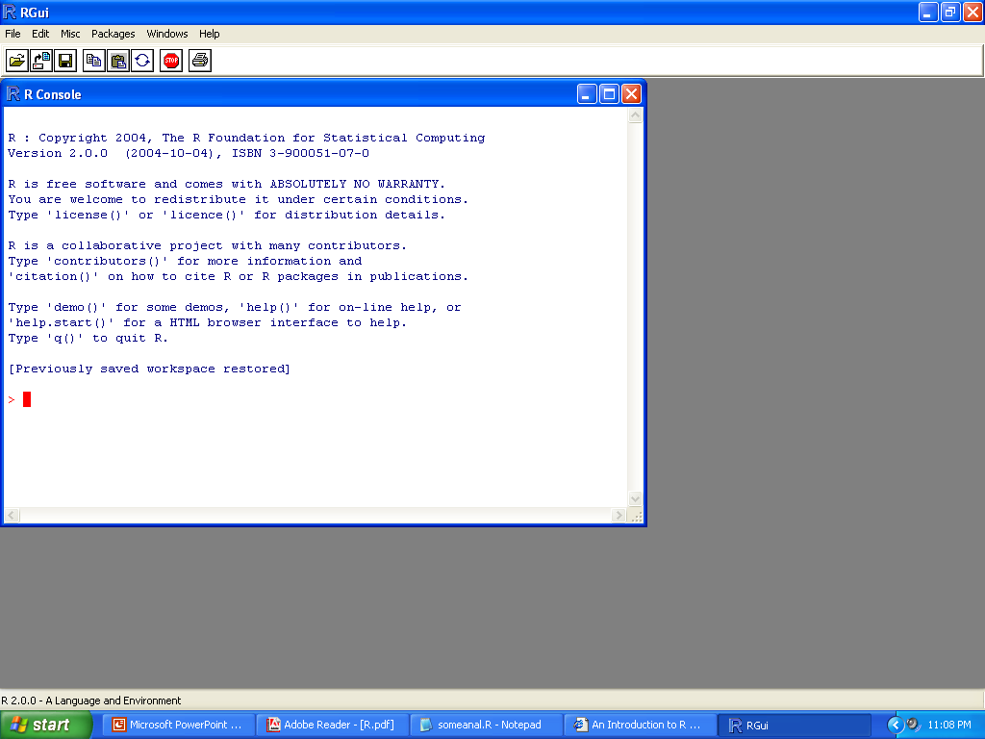
Rgui – interpreter 방식
R console
명령어 입력
명령어 수행 결과
Notes:
As you can see, above is the R working area. Here you can type your commands, write your programs, and accomplish all the tasks that you want to do with R. I find it useful to issue the command “source(“<myfile.R>”)”, where <myfile.R> is replaced with the filename you want to work with. Remember, that myfile.R must be in the same folder or directory of your R, otherwise type the full directory path. If you do not want to see the results on this screen, but would rather save it to a different program from where you can see them directly, it helps to use the command “sink(<filename.Rout>) where <filename.Rout> is replaced with the filename of your choice. We prefer to use the suffix “Rout” for R outputs so that it helps to search and distinguish this file from others.

Slide 14
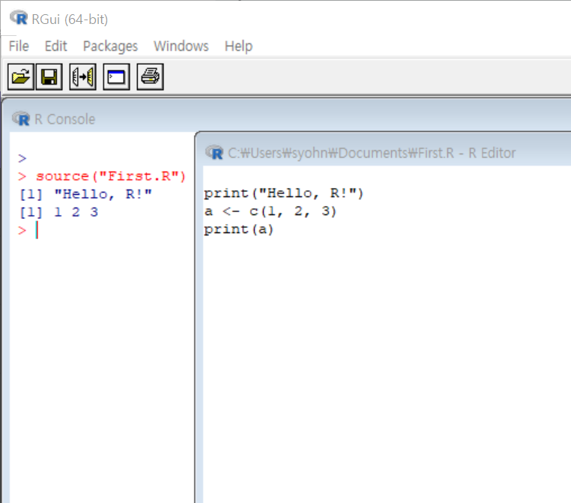
Rgui – script 실행
R editor
R script 작성
R console:
R script 를 실행: source(“First.R”)

Slide 15
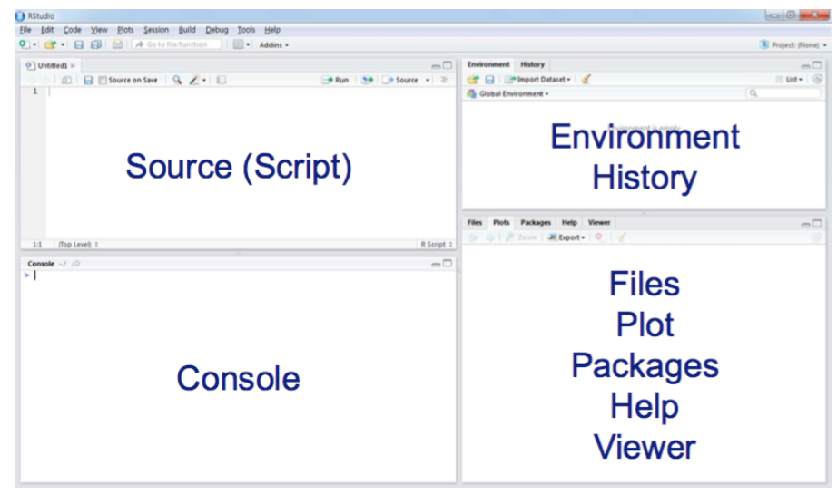
RStudio
4 panes

Slide 16
데이터 분석을 위한 R 세션
데이터 를 파일로 부터 읽어 들인다.
필요한 Package를 로드하거나, R 함수 작성
데이터 분석을 실행
결과를 테이블, 파일에 저장후
종료
필요한 경우 R workspace(R 작업공간: 사용자 및 환경 변수, 명령어 히스토리) 를 저장해 놓으면 --> 다음 세션에 이전 저장된 R workspace를 로드 하여 이전 작업 환경을 그대로 복원하여 작업을 재개 할 수 있음
Notes:
In general, when we work in an R session for doing statistical analysis, we first read the data, then use one or more packages, libraries, or sets of functions to work on the dataset. We can also write our own functions to accomplish specific tasks. We create outputs and create graphs and graphics. Save our work to a file or several files and terminate the R session. For terminate an R session, type “quit()” (note, even quit is a function), and the program asks you if it can save the R session. If you order “yes”, the session is saved as an .Rdata file and is available at a subsequent session.

Slide 17
R 기초

Slide 18
R 언어로 프로그래밍
Syntax 는 c, c++, python 과 유사함
벡터, 배열, 테이블 형식의 데이터를 처리하기에 편리함
풍부한 인덱싱 기능,
테이블을 자르고, 붙이고, 테이블 단위로 연산하고…
자동 형 변환 기능이 있어 편리하나, 단, 주의를 요함
프로그래밍시 많은 Error
R Type 에 대하여 잘 알면 R programming 절반은 배운 셈!
객체 지향, 함수형 언어
코드 읽기가 어려운 경우가
개발자, 사용자 레벨의 차이가 큼
다른 언어와 유사한 형식, 문법을 가져서 쉽게 배울 수 있지만 간혹, 예상과는 다른 의외의 결과가 나온다. → 매뉴얼

Slide 19
R 문장, 함수

Slide 20
Branching
if (logical expression) {
statements
} else {
alternative statements
}
else branch is optional

Slide 21
Loops
Iterate on sequence
for(i in 1:10) {
print(i * i)
}
I = 1
while(I <= 10) {
print(i * i)
i=i+sqrt(i)
}

Slide 22
functions and operators
Functions:
strict named argument
default argument value
함수는 nest 될 수 있다.
Operators:
+ - * / ! & | %%
Scoping rules
Lexical scoping
= Statical scoping (cf. dynamic…)
함수 선언
add <- function(a, b = 0 ) # b = 0 default 값
{
result = a + b
return(result) # one return value
}
함수 호출
add(1)
add(a, 3) 또는, add(1, b = 4)
Lexical scoping in R means that “the values of free variables are searched for in the environment in which the function was defined”.
https://bookdown.org/rdpeng/rprogdatascience/scoping-rules-of-r.html

Slide 23
functions and operators
Exceptions to the rule:
Functions may also use data that sits around in other places, not just in their argument list: “scoping rules”*
Functions may also do other things than returning a result. E.g., plot something on the screen: “side effects”
* Lexical scope and Statistical Computing.
R. Gentleman, R. Ihaka, Journal of Computational and Graphical Statistics, 9(3), p. 491-508 (2000).

Slide 24
Graphics
객체를 플롯하기: plot(num.vec)
index number 에 따라 plot
plot 결과는 그래픽 장치로 보내어짐
그래픽 장치-graphic device를 지정할 수 있다
postscript, gif, jpeg, etc…
장치를 on/off 할 수 있다: dev.off()
2 가지 형식의 plotting
high level: 그래프가 한번의 함수 호출로 그려짐 plot()
Low Level: 추가적인 정보를 그래프위에 덧칠함. point()-점, 선그리기, legend()-범례 그리기
그래프 저장하기
jpeg(), png(), or gif()
Notes:
R is a great software environment for graphing data. R base comes with its own set of graphing capabilities, in addition, you can also use libraries like lattice to draw high quality graphs. The simplest functions are plot, and learn more about plotting by using ?plot in an R session. In general, there are two different types of plotting – high level plotting, where graphs can be drawn with just one call (e.g. plot), or low level plotting, where additional lines or points can be drawn on the existing graph (for example point() function, that helps to draw lines/points on an existing graph). You can add legends to an existing graph by using the function legend(). For more information about how to draw legends, type ?legend at the command prompt. You can also save graphs to a variety of format for further actions. You can save the graphs as jpg, png, or gif formats, using jpeg(), png(), or gif() functions. After calling the plotting devices, you must turn them off by using dev.off() function. Use ?jpeg, or ?png to learn more about them.

Slide 25
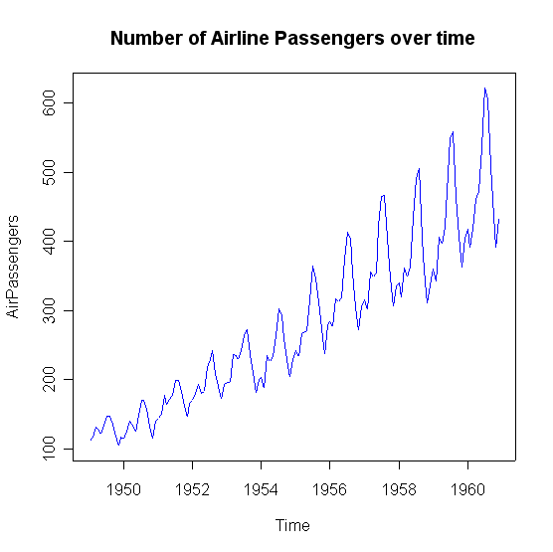
High Level: plot() 으로 그리기

Slide 26
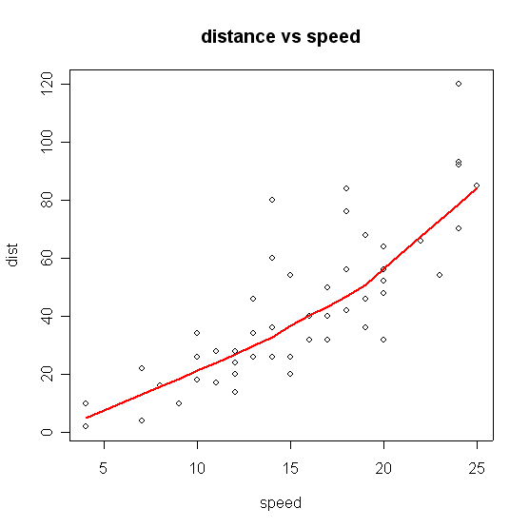
Low Level: Lowess 로 Scattergram 그리기

Slide 27
R 로 프로그래밍 하기
함수, 연산자는 벡터, 행렬 전체에 적용된다
표현식-expression 은 {} 로 싼다
명령어는 ; 로 구분할 수 있다-선택적
함수 작성
Notes:
Since R is a highly functional language, everything in R can be accomplished by using or writing functions. Rules for writing functions are very simple. You can declare a function like this: myfunction <- function(){statements}, where myfunction is the object that will be outcome of writing the function. {} indicate opening and closing of statements of the function. These are not mandatory, for instance if you plan to write a simple one-liner function, you need not put curly brackets. However, we recommend putting curly brackets to write functions for they are good practices. Semicolons are not necessary unless you want to separate two pieces of codes written in the same line.
In terms of programming in R, R itself comes with a rich set of pre-built functions that you can use. For instance, functions like “apply”, “sapply”, “tapply” accomplish looping actions quite effectively. Read about these functions by using commands like ?apply, ?sapply, ?tapply in an R session.

Slide 28
Functions in R
Descriptive Statistics
Predictive Modeling
Regressions
Classification
Time Series
…
Data preprocessing
Inbuilt Packages(R base, stats에 내장), Contributed packages(외부)
Notes:
ALL statistical functions known to date are supported in R. Some we need almost everytime, some we will perhaps never need in a lifetime. You can easily customize which functions you need. You can and should take help of numerous in built and contributed packages that are part of R. You can learn about them in the R website and in the documentation and various other tutorials. This introductory lecture cannot discuss all of them. The R base and stats package are good and powerful enough for doing most routine statistical work and drawing graphs. Type packages() at the R session to learn about the packages installed in your R.

Slide 29
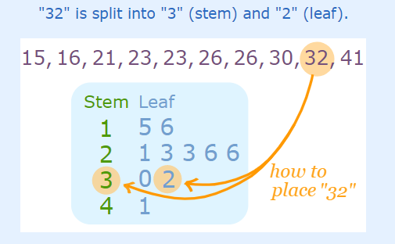
Descriptive Statistics
일반적인 통계 처리에 필요한 함수 들
summary(): min, max, mean, median, first, third quartiles
stem(): stem and leaf plot
table() 범주형 변수의 샘플 빈도수를 테이블로
Notes:
A word about summary(). Summary, in the context of individual variable in a dataset will give you information about its lowest, mean, median, quartiles, and highest values. Summary(), in the context of a dataset will give you information about _all_ the variables included in the dataset. Use it carefully. To learn the distribution of the categorical variables, it is useful to use the function table().

Slide 30
Predictive Modeling
다양한 알고리즘이 함수, 패키지로 구현
이러한 함수를 사용할 때 특별히 주의 할 사항
목표 변수 가
factor type: categorical → classicication
numeric type: continuous → regression
인지 에 따라서 자동으로 다른 목적의 모델 이 결과로 산출
애매한 경우에는 명시적으로 (factor 로) 지정
dummy 변수를 자동으로 생성
data.frame 은 편리한 데이터 구조
Notes:
A variable is a factor to R if it is a categorical variable. For example, let’s say we have a variable for occupation like:
occup={“doctor”,”engineer”,”software programmer”} – thus, the variable occup has three categories. R knows it as a factor. When used in a regression model, R will make dummy variables out of it automatically, assigning first level as reference (in this instance “doctor”). Sometimes, however, a categorical variable may contain numerical values. For example, let’s say grades for a student carry numbers like 1,2,3, and so on. We can represent grades as grades={1,2,3,4}. Here, “grades” is a categorical variable with levels 1,2,3, and 4. Unless specifically stated as factor(grades), R will treat grades as a numerical continuous variable in the context of a regression equation. This distinction between factors and regressors (continuous variables that can be put in a linear regression equation) needs to be emphasized. Also, R creates dummy variables automatically; you need not specify them in the equation.

Slide 31
How to model
Specify your model like this:
y ~ xi+ci, where
y = outcome variable, xi = main explanatory variables, ci = covariates, + = add terms
Operators have special meanings
+ = add terms, : = interactions, / = nesting, so on…
Modeling -- object oriented
each modeling procedure produces objects
classes and functions for each object

Slide 32
연산자 - Synopsis of Operators
Formula - model 식에 사용
Operator
Usually means
In Formula means
+ or -
add or subtract
add or remove terms
*
multiplication
main effect and interactions
/
division
main effect and nesting
:
sequence
interaction only
^
exponentiation
limiting interaction depths
%in%
no specific
nesting only

Slide 33
Modeling Example: Regression
carReg <- lm(speed~dist, data=cars)
carReg = becomes an object
to get summary of this regression, we type
summary(carReg)
to get only coefficients, we type
coef(carReg), or carReg$coef
don’t want intercept? add 0, so
carReg <- lm(speed~0+dist, data=cars)

Slide 34
요약하면
효율적인 효과적인 데이터 처리 및 저장
방대한, 일관성 있는 데이터 분석 도구
유용한 그래픽 도구 및 디스플레이
화면, 파일
잘 만들어진, 단순한, 효과적인 프로그래밍 도구
Notes:
To sum up this introduction to R for statistical computing, we saw that R is effective for data handling and storage. It also provides a very large set of coherent tools for data analysis. In the same program, you can recode variables, use variables for identifying their distribution, can graph them, put them into regression equation. You can do them easily using simple codes and functions that you can write. The syntax of R is very intuitive, almost like the way we speak. Thus it has a very well developed and effective programming component.

Slide 35
R 에 대한 resource
R home page
http://www.r-project.org
R discussion group
http://www.stat.math.ethz.ch/mailman/listinfo/r-help
Search Google for R and Statistics
많은 설명, 예제, 오류 대처 방법
Notes:
The R home page is perhaps the most important website and perhaps the only website that you may want to check out if you are starting out as a newbie. Do remember to subscribe to the R help mailing list. Remember that it is a very high volume list, and in a day, you can have message sizes as large as 180 kilobytes. We’d advise that you subscribe in the digest mode, and carefully read each message every day. Each daily digest contains huge amount of information, questions and answers and will help you to get working with R more easily. It is also a good habit to periodically check for R and Statistics in Google (http://www.google.com) for more information.

Slide 36
R 기초 연습
강의 들으면서 연습해 보기

